Slide 1
Simulations for Upcoming and Proposed Exoplanet Surveys as Pathfinders for Direct Imaging Missions
Patrick Newman
2025-12-04

Slide 2
Simulations for Upcoming and Proposed Exoplanet Surveys as Pathfinders for Direct Imaging Missions
Survey Simulations 1
Survey Simulations 2
Orbiting Photometric Lightsource

Slide 3
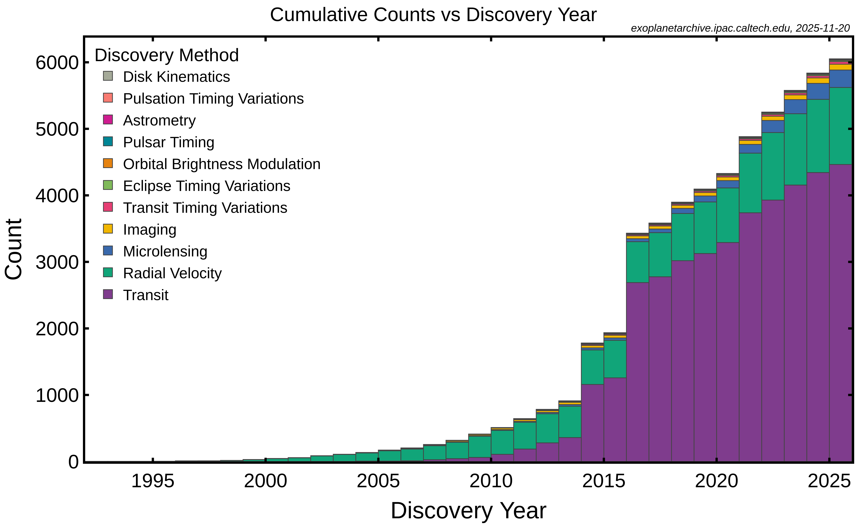
Simulations for Upcoming and Proposed Exoplanet Surveys as Pathfinders for Direct Imaging Missions

Slide 4
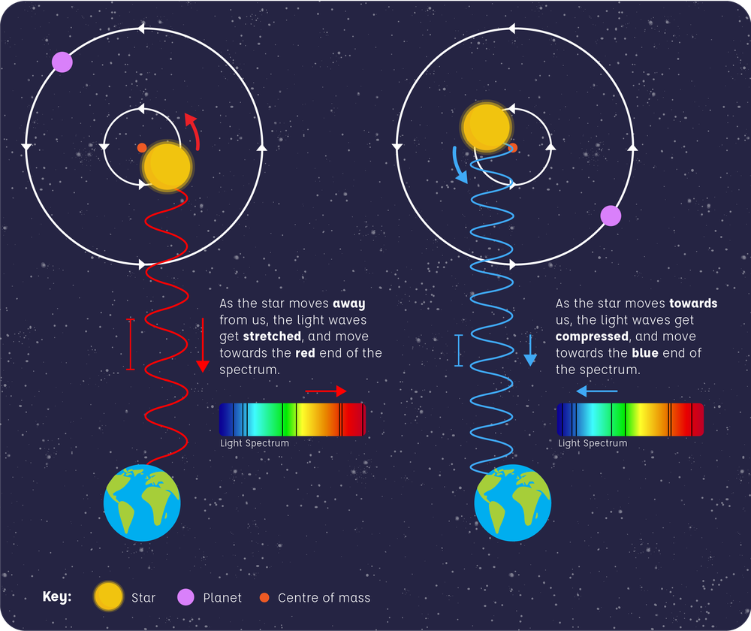
Radial Velocity Method
Image: Alice Hopkinson, LCO. Based on the Radial Velocity Method diagram by Jessica Barton, LCO

Slide 5
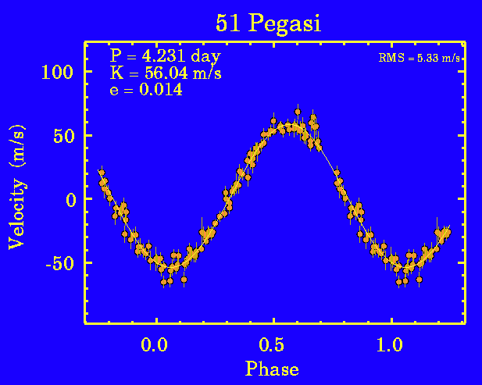
Radial Velocity Method
Image: exoplanets.org

Slide 6
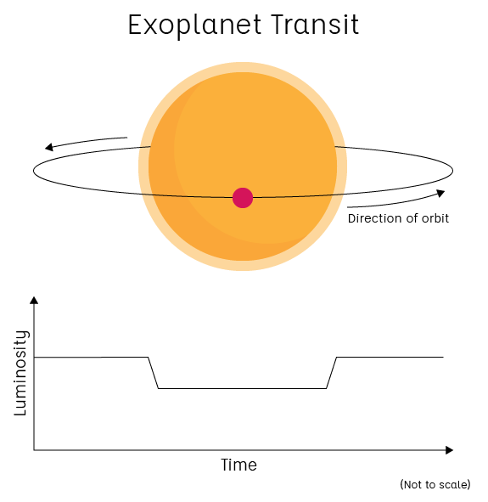
Transit Method
Image: LCO

Slide 7
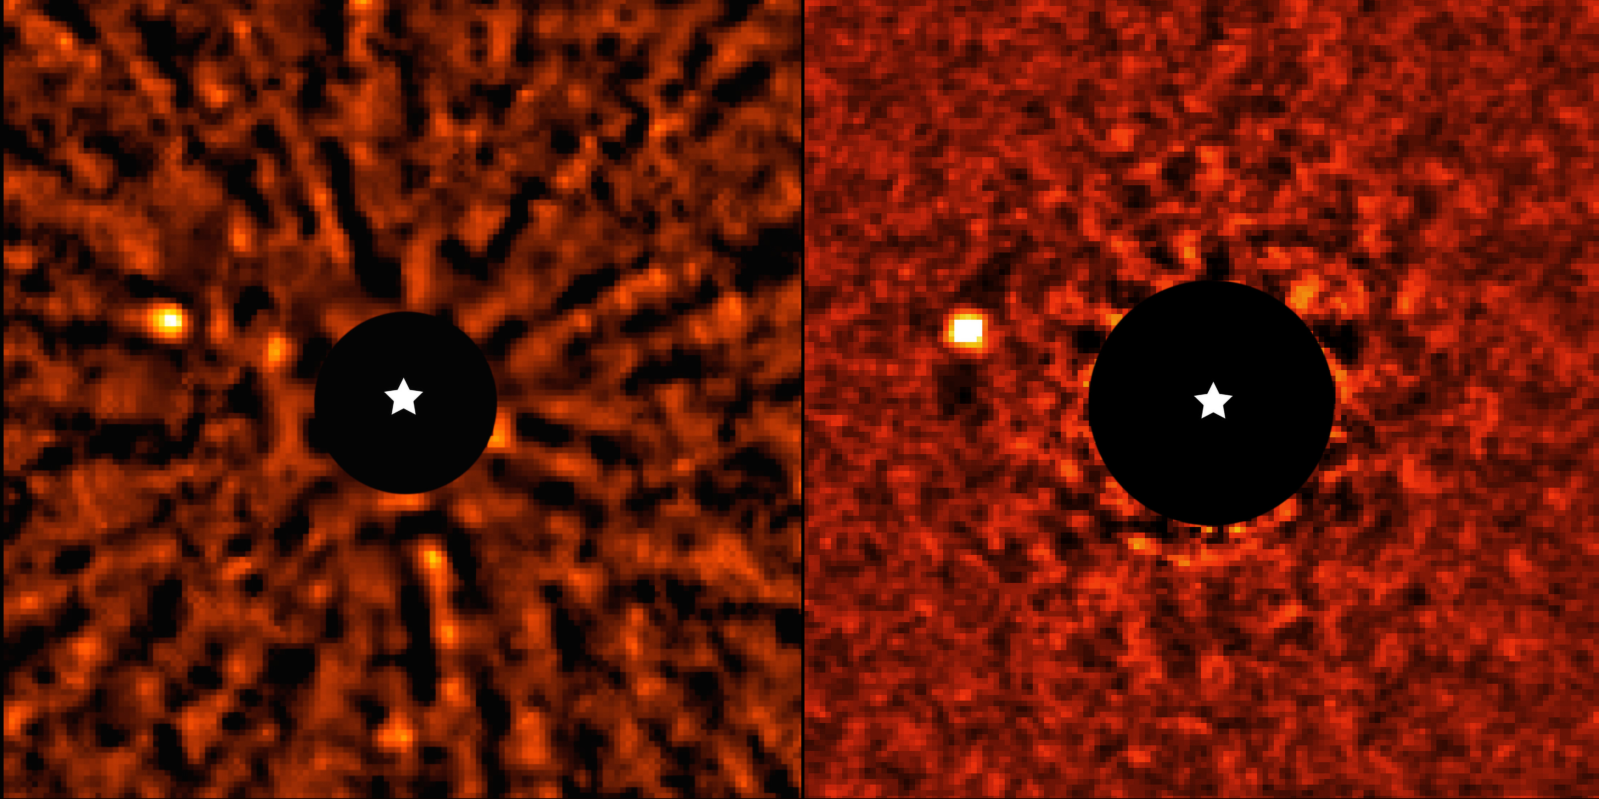
Direct Imaging
AF Lep b. Image: ESO/Mesa, De Rosa et al.

Slide 8
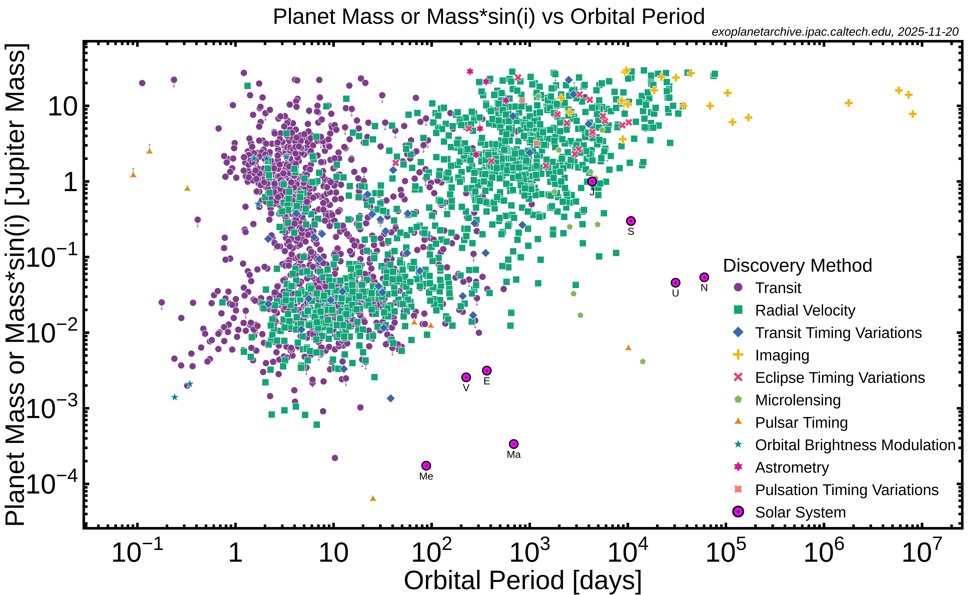
Simulations for Upcoming and Proposed Exoplanet Surveys as Pathfinders for Direct Imaging Missions

Slide 9
Carmenes – Terrestrial Planets around M-dwarfs
High resolution visible/near-IR spectrograph (520-1710 nm)
Has so far (late 2025) found 57 planets around M-dwarfs and 12 around earlier stars. Also confirmed another 27.
Some are Earth-mass, but M-dwarf planets are difficult to directly image and transiting ones need JWST to characterize atmospheres.

Slide 10
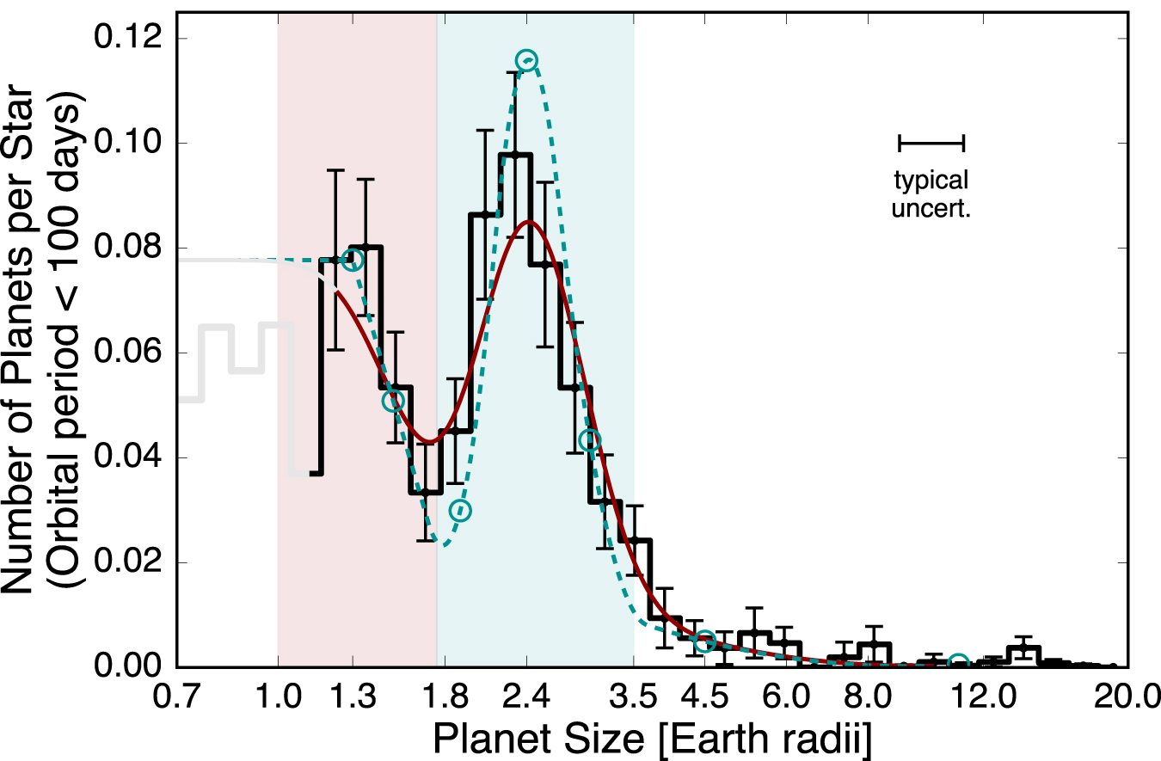
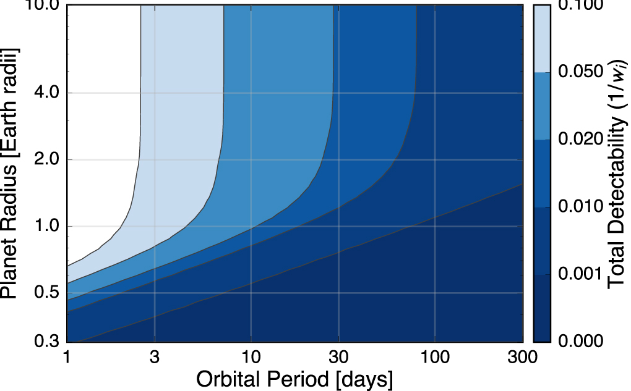
California-Kepler Survey and the Radius Gap
Visible spectrograph on Keck following up on transiting planets.
Lots of demographics, but iffy at smaller sizes and only for close-in planets.
(Fulton et al al 2017)

Slide 11
Survey Simulations 1
Direct Imaging characterization benefits from having planets with known orbits and masses.
RV probes a different parameter space than transits (or direct imaging).
What can current/near-future EPRV surveys do to find planets?

Slide 12
Survey Simulations 1 – Motivation
“NASA and NSF should establish a strategic initiative in extremely precise radial velocities (EPRVs) to develop methods and facilities for measuring the masses of temperate terrestrial planets orbiting Sun-like stars” – 2018 National Academies Exoplanet Science Strategy Report

Slide 13
Survey Simulations 1
Part of NASA-NSF Extreme Precision Radial Velocity Initiative
Gather community architectural designs.
Simulate surveys.
Which ones work best/are highest yield?

Slide 14
Simulations for Upcoming and Proposed Exoplanet Surveys as Pathfinders for Direct Imaging Missions
Survey Simulations 1
Survey Simulations 2
Orbiting Photometric Lightsource

Slide 15
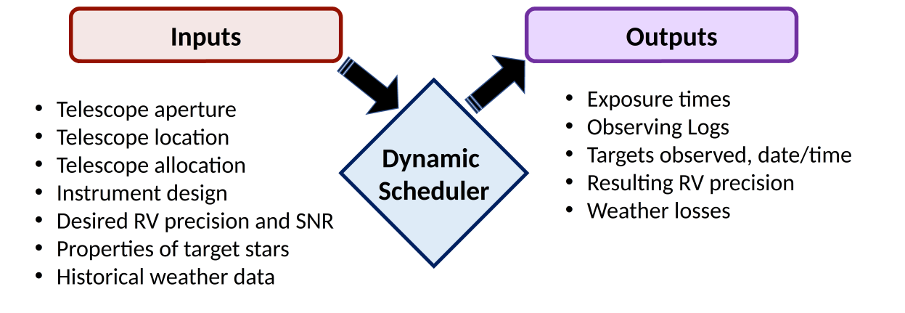
Survey Simulations 1 – Code Outline

Slide 16
Survey Simulations 1 – Radial Velocities
Code from Beatty et al 2015
Simulated Stellar Spectra and their RV content (but not activity)
Effective Temperature, metallicity, surface gravity, rotational velocity, macroturbulence (if available)
Telescope size, spectrograph R, detector size and noise, system throughput/efficiency
Atmosphere model

Slide 17
Survey Simulations 1 – Exposure Time Calculation
Target either SNR or RV value
Find RV/SNR when the peak part of the detector is saturated (“guess RV” and “guess time”)
Scale by time = guess time*(target RV/guess RV)^2
This can be for multiple exposures (and readout times will be noted)
P-mode scaling

Slide 18
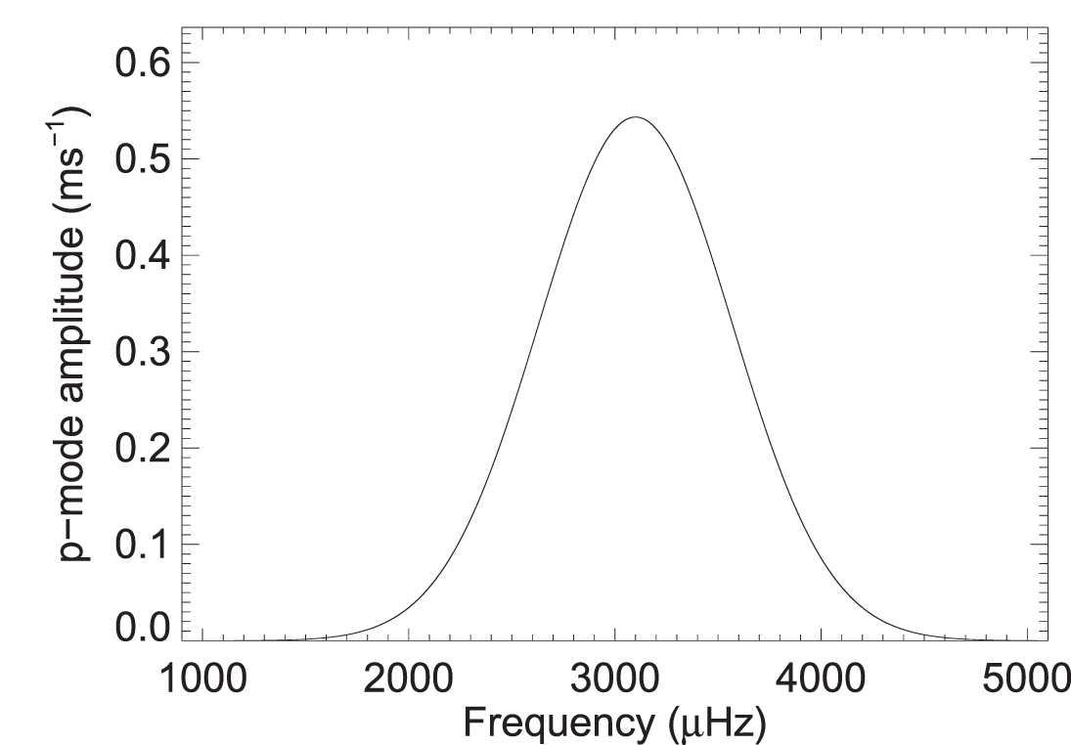
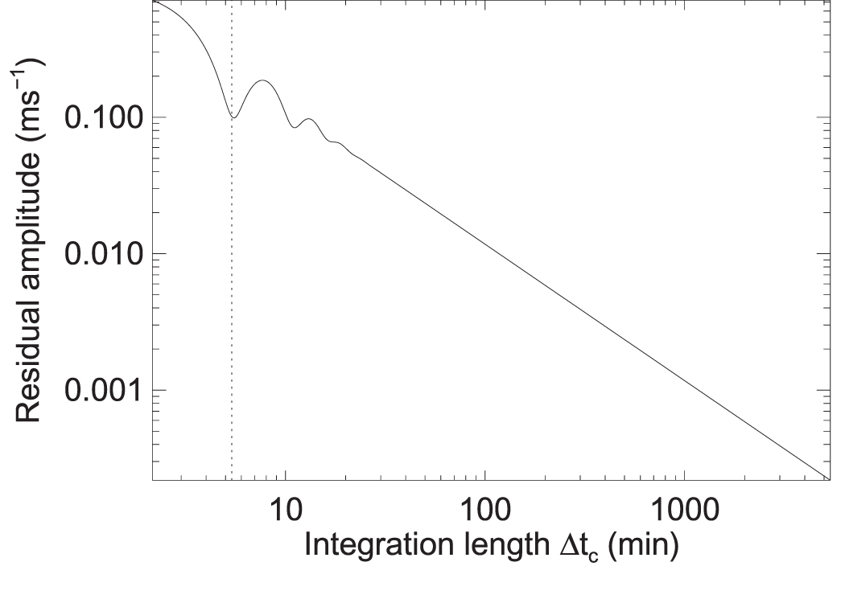
Survey Simulations 1 – P-modes
Stars wobble and oscillate. For sun-like stars, the pressure mode (p-mode) is the most important. This adds a periodic RV “signal” that we want to remove by exposing over the period of an oscillation. (Chaplin et al 2019)
Fixed 5 minute (and later 10 minute) minimums to cover typical and worst cases in the sample stars.

Slide 19
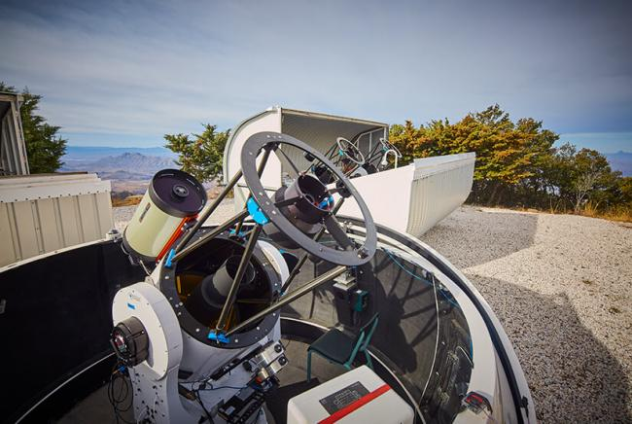
Survey Simulations 1 – Dispatch Scheduler
MINERVA Telescopes
Credit: CfA/Rick Peterson

Slide 20
Survey Simulations 1 – Dispatch Scheduler
Derived from MINERVA’s observation program
Picks targets “on the fly”
Slew time, sun angle, telescope lat/long/alt, pointing limits, moon avoidance, weather

Slide 21
Survey Simulations 1 – Dispatch Scheduler
Typical night
Advance time to “full dark” (default -12° altitude for Sun)
Check to see if the night is clear, or lost due to weather
If the night is cloudy, advance time to dawn
If the night is clear, prep target list (determining which stars are observable due to sufficient separation from the moon, and being above the horizon)
Begin observation loop
Observation loop
Generate weightings for the target stars
Pick highest weighted target
If the target has a positive weight, observe it for the duration specified
Wait five minutes (this is done whether or not a target is observed.)
Repeat until dawn

Slide 22
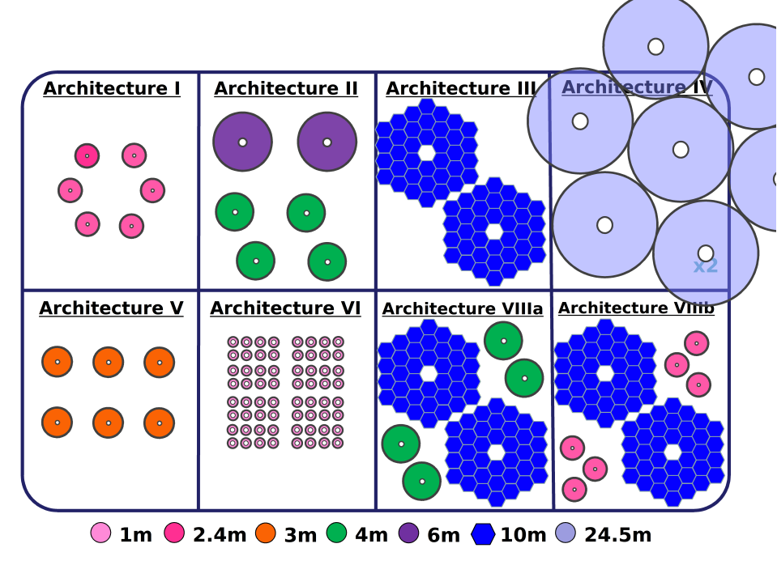
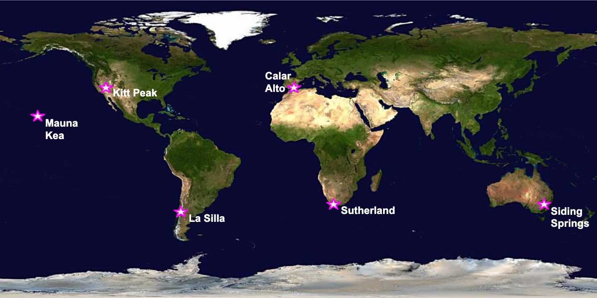
Survey Simulations 1 - Architectures

Slide 23
Survey Simulations 1 - Architectures
Differing telescope sizes and availability
Defined Instrument (NEID)
“Champion” Instrument (varies per-architecture)
Peak SNR vs single measurement RV precision
Final selection was 7 telescope/spectrograph combinations

Slide 24
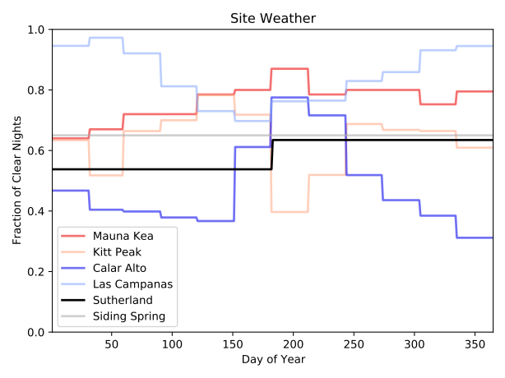
Survey Simulations 1 – Site Locations
“Typical” locations with existing observatories

Slide 25
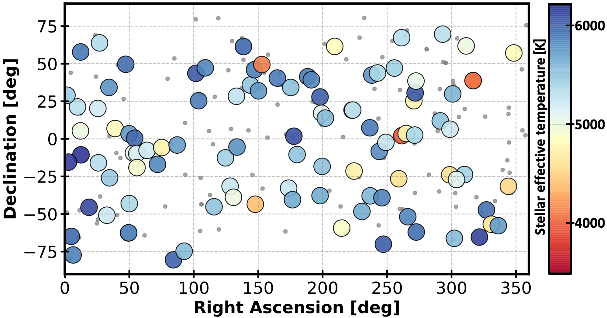
Survey Simulations 1 - Green Prime Targets
101 FGK stars within 5 pc, low vsin(i), and low stellar activity.
Two groups: 58 >-5° Dec, and 62 <+5° Dec (19 star overlap).

Slide 26
Survey Simulations 1 – Detection Heuristic
Computationally cheap (no injection/recovery tests).
Can split up σ and observation counts, depending on what we’re modeling.

Slide 27
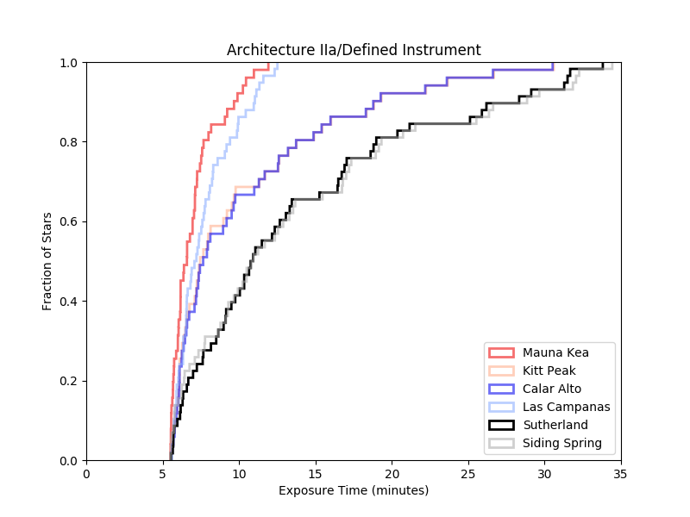
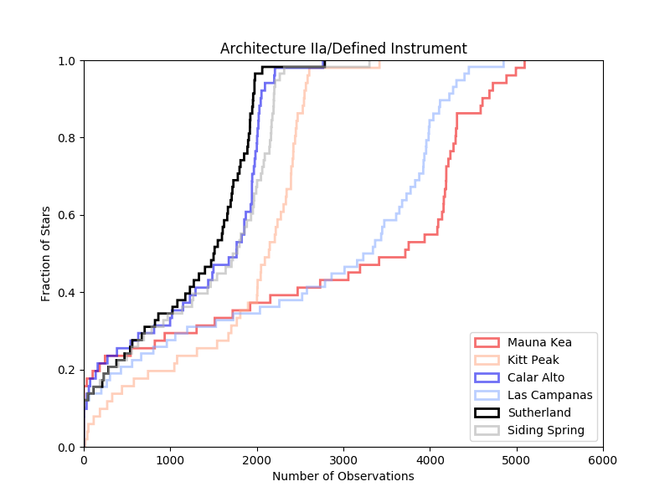
Survey Simulations 1 – Example Results
(example time-series)

Slide 28
Survey Simulations 1 – Results
How often was a star observed?
How well was a telescope used?
How small of a planet could we find?

Slide 29
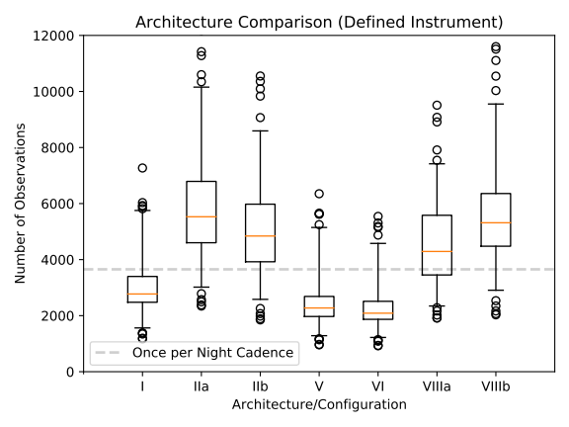
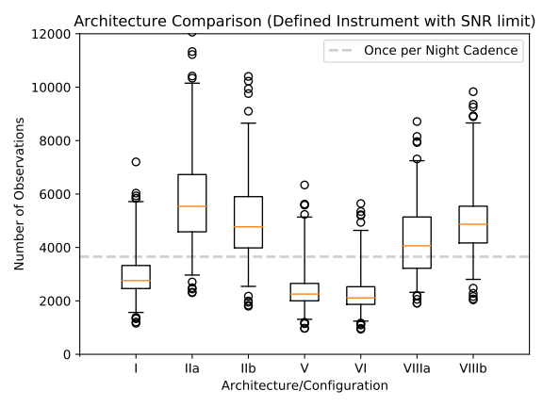
Survey Simulations 1 - observations

Slide 30
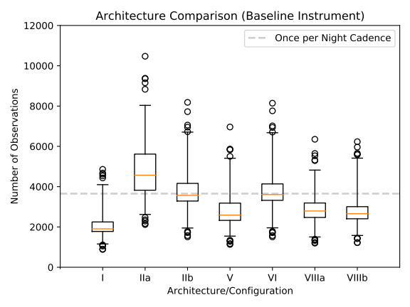
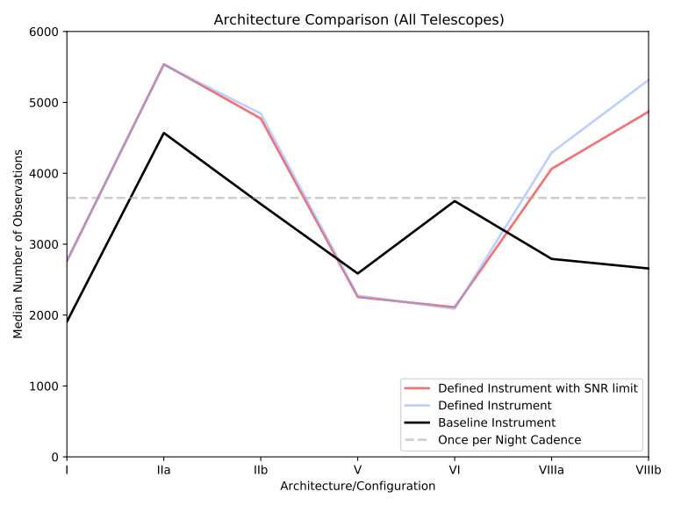
Survey Simulations 1 - observations

Slide 31
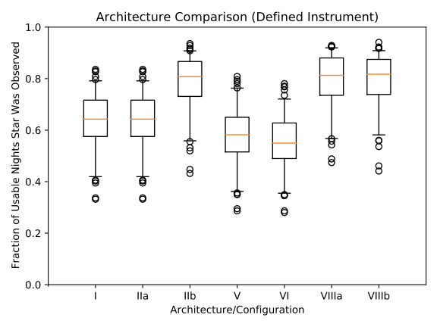
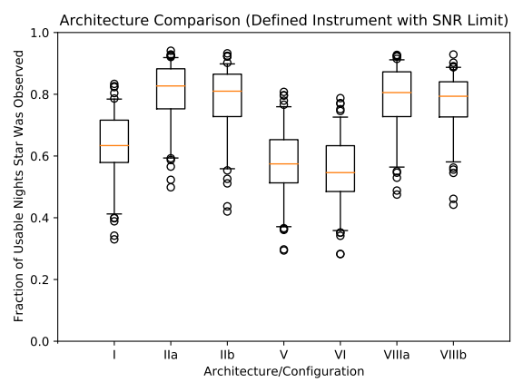
Survey Simulations 1 - utilization

Slide 32
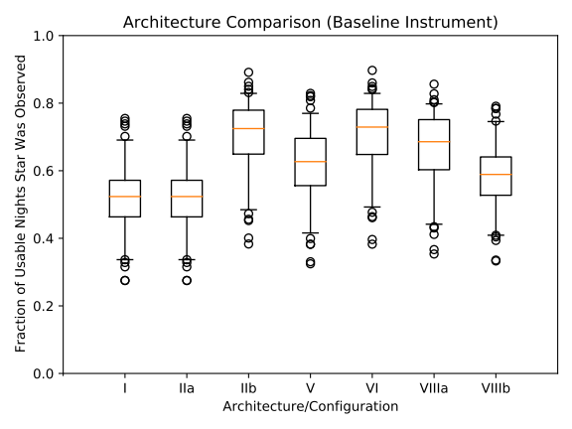
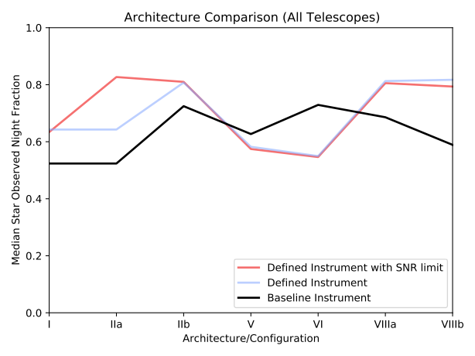
Survey Simulations 1 - utilization

Slide 33
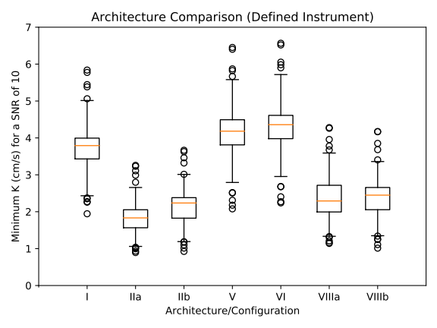
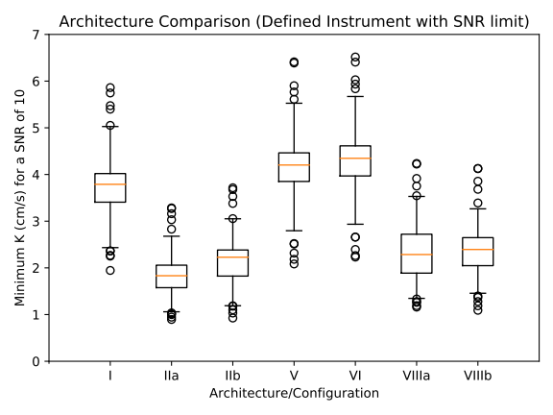
Survey Simulations 1 – detected semi-amplitude

Slide 34
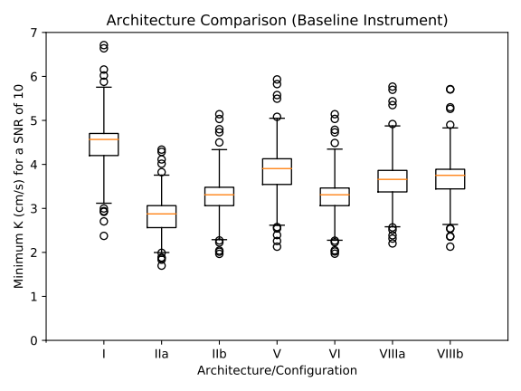
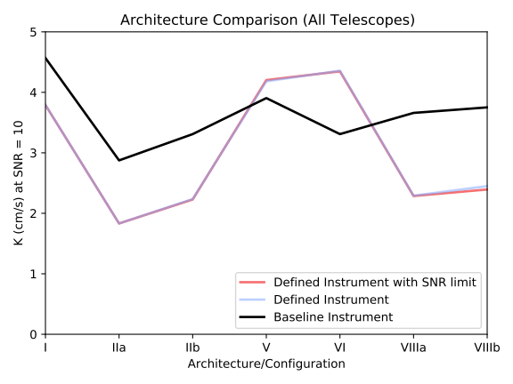
Survey Simulations 1 – detected semi-amplitude

Slide 35
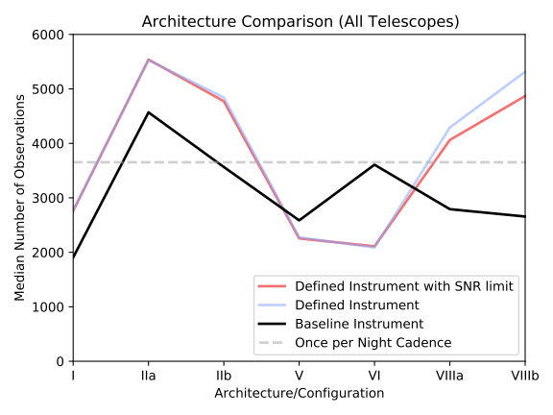
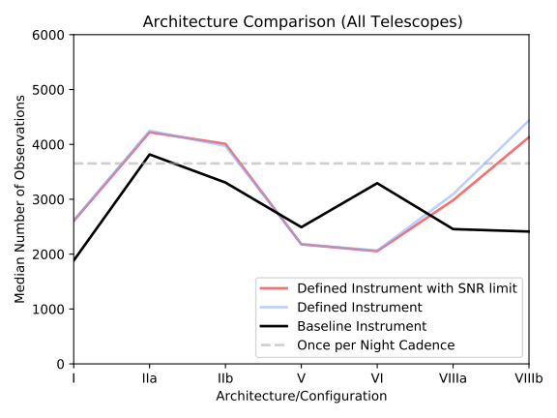
Survey Simulations 1 – p-mode aside

Slide 36
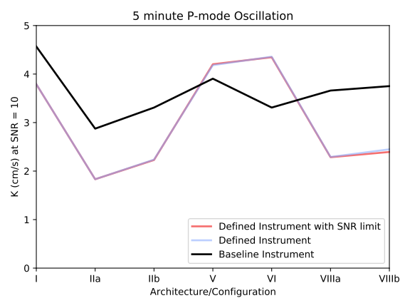
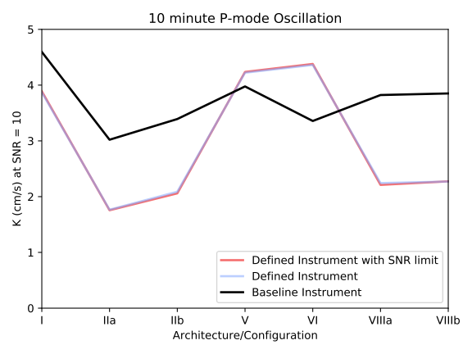
Survey Simulations 1 – p-mode aside

Slide 37
Survey Simulations 1 – Conclusions
Most architectures can work okay, though fully dedicated 4+ m telescopes are best.
More telescopes at more locations solve everything. (but fewer might work)
Exposure times based on single measurement RV precision and on target SNR give similar results.
Going from 5 to 10 minute p-modes changes observation count but not survey sensitivity!

Slide 38
Simulations for Upcoming and Proposed Exoplanet Surveys as Pathfinders for Direct Imaging Missions
Survey Simulations 1
Survey Simulations 2
Orbiting Photometric Lightsource

Slide 39
Survey Simulations 2
Are the exposure time and dispatch scheduler assumptions good?
Atmosphere/How much do microtellurics matter?
Stellar activity/Laying p-mode oscillations to rest.
How much does target selection matter?

Slide 40
Survey Simulations 2 – Architectures
Spectrographs:
NEID (the existing one)
NIRS (a nominal near infrared spectrograph)
Telescopes:
WIYN (3.5 m), LBT (8.4 m, 11.8 m)
Target precisions:
40 cm/s, 27 cm/s, 9 cm/s, 3 cm/s

Slide 41
Survey Simulations 2 – Architectures
Canonical:
NEID/WIYN 27 cm/s
NEID/WIYN 3 cm/s
NEID/LBT 3 cm/s
NIRS/LBT 40 cm/s
NIRS/LBT 3 cm/s
Non-canonical: every combination (40/27/9/3 cm/s)

Slide 42
Survey Simulations 2 – Target Lists
Stapelfedt and Mamajek 2023 (HWO)
Green Prime (EPRV)
A previous list (HabEx)
Different but related requirements.

Slide 43
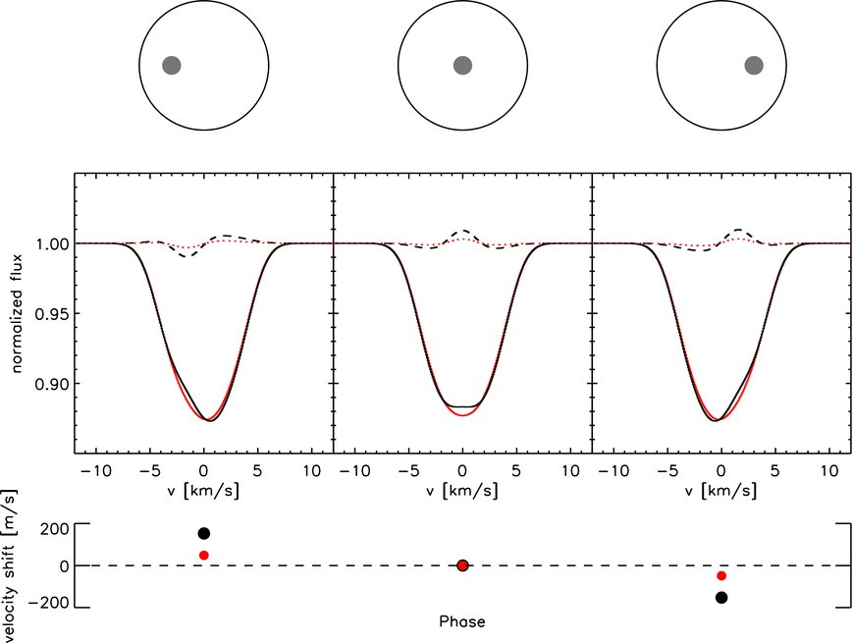
Survey Simulations 2 – Unsimulated Stellar Activity
Starspots introduce a (potentially very large) periodic RV signal as they cross the stellar disk. This effect is smaller in NIR than visible (Reiners et al 2010). We do not directly compensate for this.

Slide 44
Survey Simulations 2 – “Solving” p-mode oscillations
Solar-type oscillations introduce additional noise, and there’s a minimum observation time to minimize the effect (Chaplin et al 2019). The mismatch from an approximate value significantly reduces the effectiveness of this sort of compensation (Luhn et al 2023).

Slide 45
Survey Simulations 2 – “Solving” p-mode oscillations
Nominal times
Dynamical timescale
Chaplin 2019 et al, etc

Slide 46
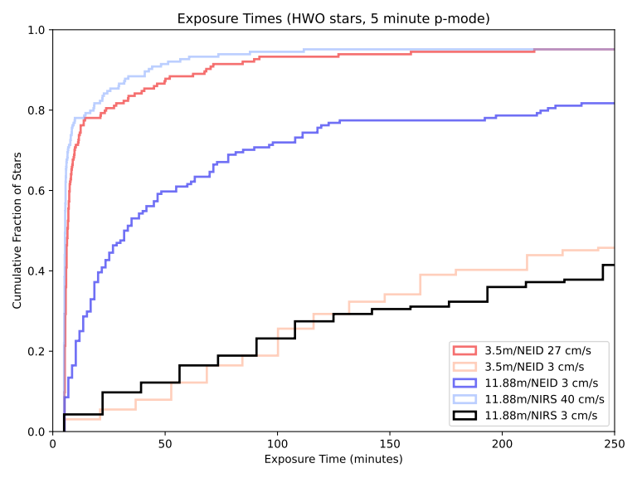
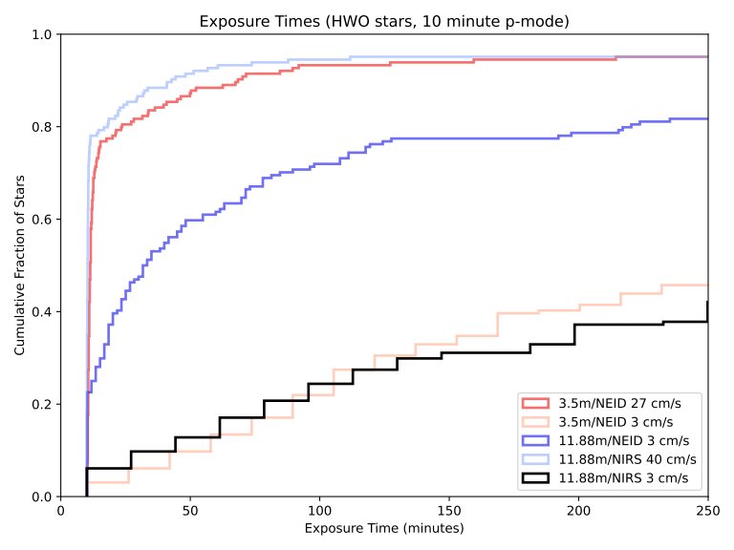
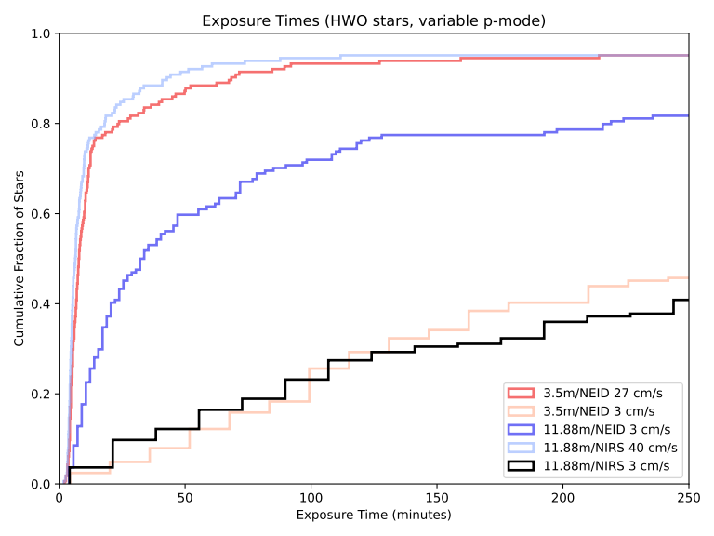

Survey Simulations 2 – “Solving” p-mode oscillations
Only the short exposures change
Those exposure times are still short with observing for a full p-mode (the HWO list doesn’t have much in the way of subgiants).
So probably no penalty for accurately accounting for this noise source.

Slide 47
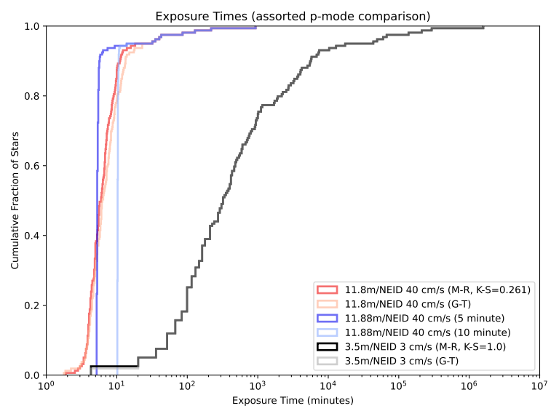
Survey Simulations 2 – “Solving” p-mode oscillations

Slide 48
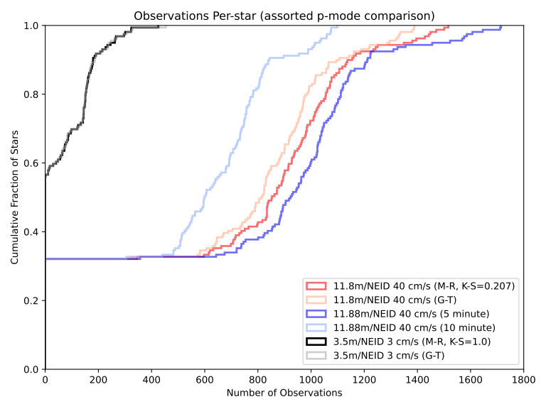
Survey Simulations 2 – “Solving” p-mode oscillations

Slide 49
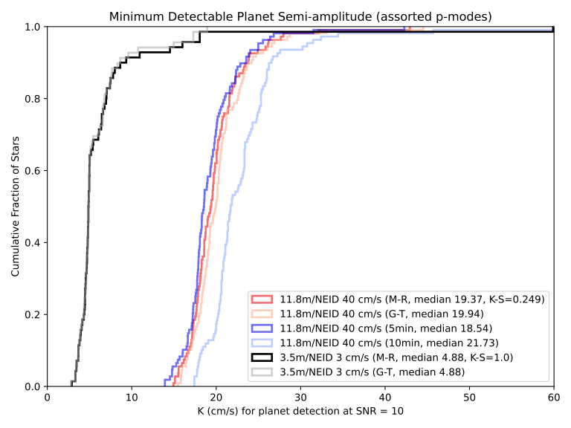
Survey Simulations 2 – “Solving” p-mode oscillations

Slide 50
Survey Simulations 2 – “Solving” p-mode oscillations
This part of stellar activity is easy to compensate for.
Outside of unlikely cases, exposure times are minimally affected.

Slide 51
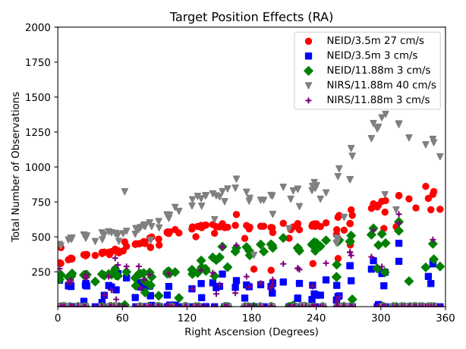
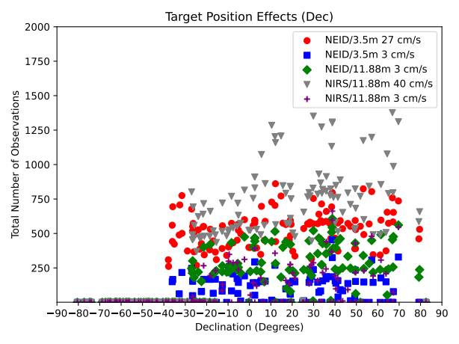
Survey Simulations 2 – Target Star Properties (HWO)

Slide 52
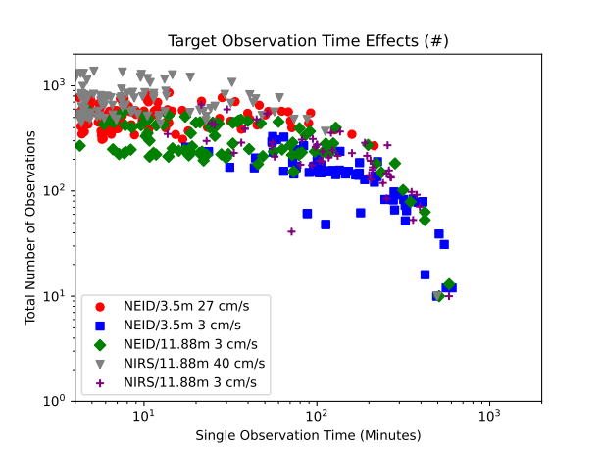
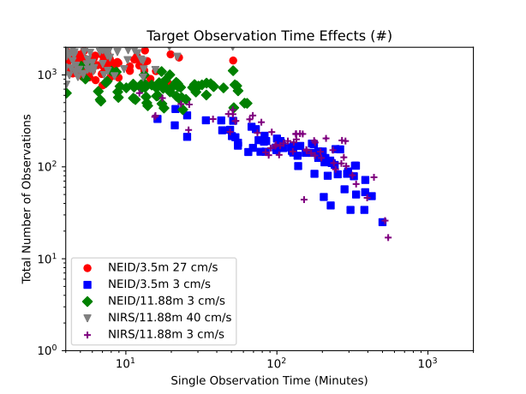
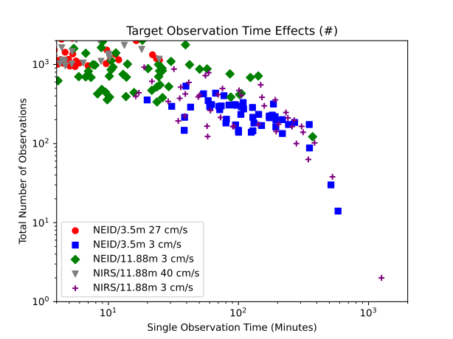
Survey Simulations 2 – Target Star Properties (HWO, EPRV, HabEx)
Selecting for targets that are EPRV friendly may be needed, regardless of direct imaging wants

Slide 53
Survey Simulations 2 - Microtellurics
My atmospheric model lacks line absorption (as losses), and assumes that noise from telluric lines can be fully corrected.
How much do microtellurics matter?

Slide 54
Survey Simulations 2 - Microtellurics
We can add in a noise term to approximate uncorrected microtellurics.
Using σatmosphere of 3 cm/s visible, 115 cm/s NIR
(S. X. Wang et al. 2022)

Slide 55
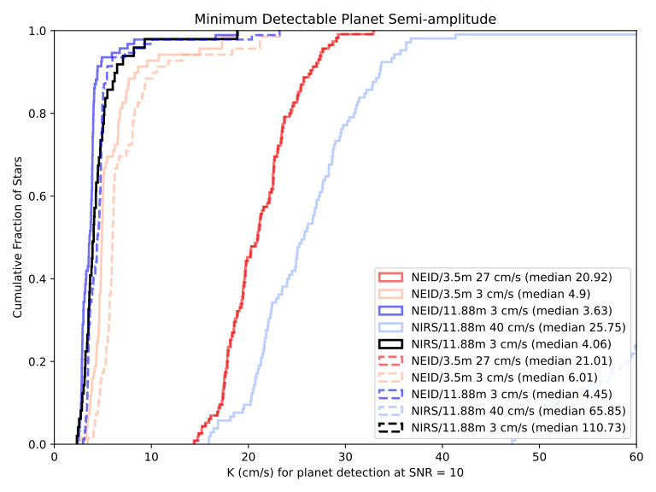
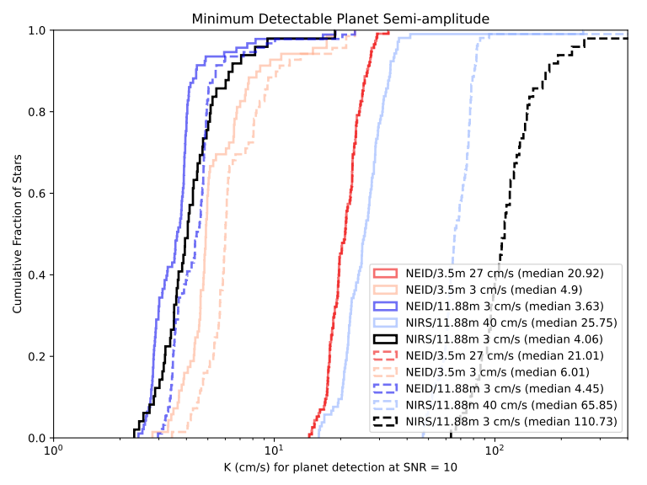
Survey Simulations 2 – Microtellurics
Acceptable in visible (3 cm/s), but a showstopper (115 cm/s) if we need to use NIR.

Slide 56
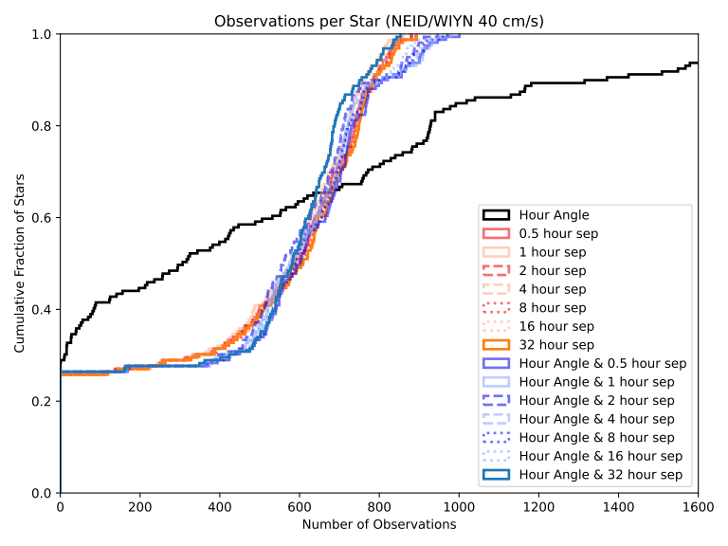
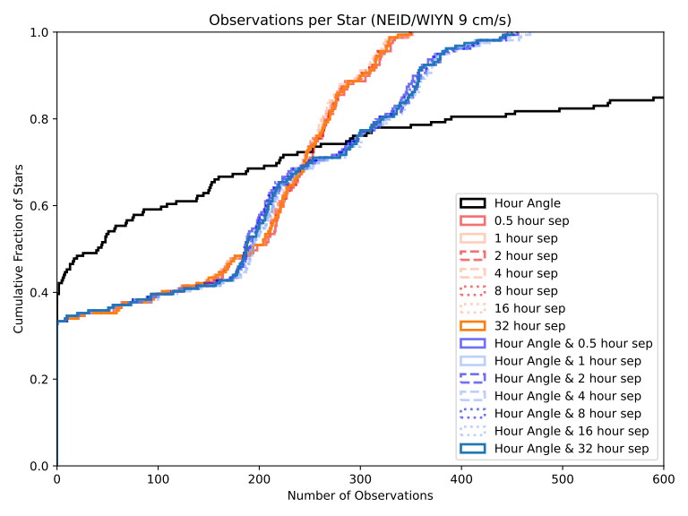
Survey Simulations 2 – Justifying the Weighting
Very easy to calculate and approximates real world usage numbers.
“Best” isn’t always Hour Angle & 2 hour separation.
Don’t want to solve the traveling telescope problem. (Garcia-Piquer et al 2017, Handley et al 2024 A&B look at observation programs more generally but more constrained exptimes and/or target lists)

Slide 57

Survey Simulations 2 – Is the Weighting Justified?
Don’t want to solve the traveling telescope problem. Garcia-Piquer et al 2017 use 3 nested schedulers (long, medium, and short term).
Handley et al 2024 A&B look at observation programs more generally but more constrained exptimes and/or target lists. Compared with heuristics, they list going from minutes of slew to seconds.
Lubin et al 2025 may have found a computationally cheap, if currently site-specific way to deal with it.

Slide 58
Survey Simulations 2 – Justifying the ETC
Exposure Time Calculators (ETCs) are mission-specific.
NEID ETC uses Teff and V-mag only.
ESPRESSO uses more but is primarily for extragalactic surveys and/or few targets.

Slide 59


Survey Simulations 2 – Justifying the ETC
General agreement with NEID ETC on Teff trends

Slide 60


Survey Simulations 2 – Justifying the ETC
But including radius, vsin(i), log(g), metallicity, and p-modes changes everything.

Slide 61


Survey Simulations 2 – Justifying the ETC
Uncertainty sources: lines from effective temperature (T), overall luminosity (L), luminosity from blackbody peak vs bandpass (BB), rotation (VS), macroturbulence (VM), surface gravity (G), and spectral resolution (R). (Beatty et al 2015)

Slide 62
Survey Simulations 2 - Conclusions
Target list size and exposure times matter a lot.
Declination matters a moderate amount.
Right Ascension technically matters.
If we need/want NIR, we need better telluric corrections.
We can “solve” p-modes entirely (though other stellar noise sources remain).
There’s a case to be made for better weighting, but that would be a whole paper (or multiple papers) into itself.
My exposure times are probably trustworthy, but there could be large missing systematics.

Slide 63
Simulations for Upcoming and Proposed Exoplanet Surveys as Pathfinders for Direct Imaging Missions
Survey Simulations 1
Survey Simulations 2
Orbiting Photometric Lightsource

Slide 64
Orbiting Photometric Lightsource – Why?
Good relative photometric precision
Bad absolute photometric precision
HST calibration based on 3 DA stars
Good physically understood calibrators in labs, but are not end-to-end for telescopes (atmosphere and stellar properties)
Can also tune brightness and use as AO target

Slide 65

Orbiting Photometric Lightsource – Why?
Albert 2012 used 532 nm laser on CALIPSO to calibrate extinction. This was an Earth observation platform, with an orbit not designed for ease observing the satellite.
ORCAS (Peretz et al 2021) looks into orbits that can do more.

Slide 66

Orbiting Photometric Lightsource – Why/How?
ORCASat 2022
“Artificial star”/satellite in orbit – known properties
What light-sources are best, and where should it go?

Slide 67
Orbiting Photometric Lightsource – How?
Simulate sources – how bright at what distance
Blackbody and LED
Detectors at many photometric bands
Many source dispersions (though not profile details)
No atmosphere

Slide 68


Orbiting Photometric Lightsource – How?
Integrating sphere is lambertian, but has large dispersion.
Collimated optics can be (almost) arbitrarily focused, but need to consider gaussian beam profile and aiming.
Bare fibres as an ‘intermediate’ (and simple) option.

Slide 69


Orbiting Photometric Lightsource – Black Body (GEO)

Slide 70


Orbiting Photometric Lightsource – Black Body (L2)

Slide 71


Orbiting Photometric Lightsource – LED (GEO)

Slide 72


Orbiting Photometric Lightsource – LED (L2)

Slide 73
Orbiting Photometric Lightsource – Results
Need LEDs to keep power in line
Want LEDs anyway for covering lots of bands
Need some degree of collimation (unless you launch a cubesat from the ISS)
Difficult to use distant orbits

Slide 74
Summary of Thesis Findings
Survey Simulations 1:
Most architectures can work okay, though fully dedicated 4+ m telescopes are best.
More telescopes at more locations solve everything. (but fewer might work)
Exposure times based on single measurement RV precision and on target SNR give similar results.
Going from 5 to 10 minute p-modes changes observation count but not survey sensitivity!
Survey Simulations 2:
Target list size and exposure times matter a lot.
Declination matters a moderate amount.
Right Ascension technically matters.
If we need/want NIR, we need better telluric corrections.
We can “solve” p-modes entirely (though other stellar noise sources remain).
There’s a case to be made for better weighting, but that would be a whole paper (or multiple papers) into itself.
My exposure times are probably trustworthy, but there could be large missing systematics.
Orbiting Photometric Lightsource:
Need LEDs to keep power in line
Want LEDs anyway for covering lots of bands
Need some degree of collimation
Difficult to use distant orbits

Slide 75
Bonus Slide(s)

Slide 76
Bonus Slide(s)
Exposure time calculations assumed 10° Zenith angle
There are lots of text files (including CSVs) as output if wanted
(Simulations 1 had some sims pull double duty)
(Simulations 2 has many “non-canonical” sims)
Weighting includes MINERVA’s 3 obs/night attempt (sort of)
Weighting does not include our 2016-2017 attempts

Slide 77
Bonus Slide(s) – atmosphere model
2 component continuum model.
Rayleigh and gray haze, both have the same scale height (8400 m by default).
Slab, no refraction.

Slide 78


Bonus Slide(s) – Sites/Weather/Time
Target properties and per-site list optimization (RA/Dec/Time) could be studied more formally.

Slide 79


Bonus Slide(s) – Sites/Targets/Weather/Time
Lubin et al 2025 do that, though specifically for Keck

Slide 80

Bonus Slide(s) – Champion Architectures

Slide 81

Bonus Slide(s) – p-mode oscillations (canonical)

Slide 82

Bonus Slide(s) – p-mode oscillations (canonical)

Slide 83

Bonus Slide(s) – p-mode oscillations (canonical)

Slide 84


Bonus Slide(s) – p-mode oscillations (all obs)

Slide 85


Bonus Slide(s) – p-mode oscillations (all K)

Slide 86

Bonus Slide(s) – Target List Comparisons (exptime)

Slide 87

Bonus Slide(s) – Target List Comparisons (obs)

Slide 88

Bonus Slide(s) – Target List Comparisons (K)

Slide 89
Survey Simulations 1 – Overview (bonus?)
6 architectures
6 sites
10 year baseline
101 stars
Want relative performance in detecting exoplanets, what features matter most?

Slide 90
Survey Simulations 2 – “Solving” p-mode oscillations
2 different fixed, and 2 different stellar property versions
All are computationally cheap, and can easily be adjusted if we get better data on the host stars that requires tweaking them.
Compare survey results: the observing time penalties are small!

Slide 91
Survey Simulations 2 – Outline (bonus?)
Previously: the weighting is “good enough” and very cheap computationally.
Other methods exist, but are tightly bound to a specific telescope (Garcia-Piquer et al 2017), very computationally intense (Handley et al 2024), or both. We don’t want to solve the traveling telescope problem.
Already re-weight list after every observation
Our exposure times are physically motivated and plausible, but should be better confirmed.

Slide 92
Some of the survey landscape
CPS/CKS, HARPS, CARMENES, Terra Hunting Experiment
California Planet Survey and the mass-radius gap. (and other occurrence rates)
CARMENES pushing into NIR for finding planets around M-dwarfs in the solar neighborhood
HARPS as a gold standard for PRVs

Slide 93


Survey Simulations 2 – Justifying the Weighting
Very easy to calculate and approximates real world usage numbers.
“Best” isn’t always Hour Angle & 2 hour separation.
Don’t want to solve the traveling telescope problem. (Garcia-Piquer et al 2017, Handley et al 2024 A&B look at observation programs more generally but more constrained exptimes and/or target lists)

